Slide 1

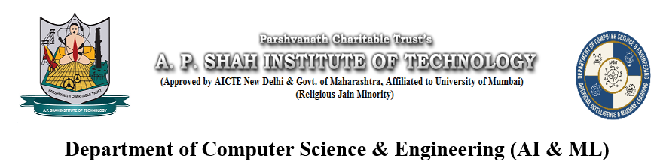
AI Based Pre-Wedding Video Generator
Soham Shelke - 23106044
Atharva Tawde - 23106122
Atharva Samant-23106057
Raunak Panigrahi - 23106092
Project Guide
Dr. Jaya Gupta
Academic year 2025-26

Slide 2
Outline
Introduction
Literature Survey of the Existing Systems
Problem Statement
System Design
Technologies and Methodologies
Conclusion
References
Notes:
<number>

Slide 3
Introduction
Pre-wedding videos are a popular way for couples to showcase their journey before marriage.
There’s a growing demand for creative and personalized digital content.
Many couples face challenges like:
High production costs
Time constraints
Lack of technical skills or access to professionals
This project aims to leverage AI-driven automation to simplify and enhance pre-wedding video generation.
Notes:
<number>

Slide 4
Motivation:-
Many couples desire cinematic pre-wedding videos but face budget limitations.
AI now enables automated creation of visuals, music, and voiceovers.
Rising demand for personalized, story-driven content inspired by couples' unique journeys.
Objectives:-
To develop an AI-based system to generate pre-wedding videos.
To Make high-quality video production more accessible, creative, and cost-effective.

Slide 5
Problem Statement
To design and implement an AI-driven solution for automated, personalized, and cost-effective pre-wedding video generation.

Slide 6
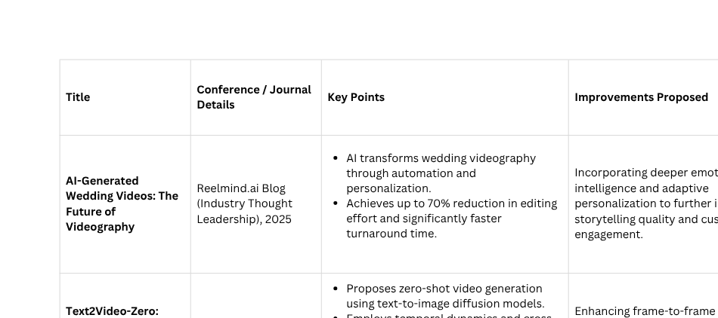
Literature Survey of the Existing System
Notes:
<number>

Slide 7
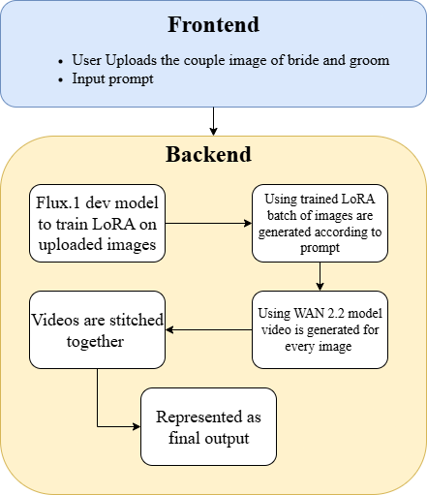
System Architecture & Workflow
Notes:
<number>

Slide 8
Technologies and Methodologies
Frontend:
Gradio Web Interface
Backend & Processing:
Runtime: Python 3.x
Web Framework: Gradio built-in server
GPU Acceleration: CUDA with PyTorch
AIML tech stack:-
Core Models:
FLUX.1 (for image gen)
W.A.N 2.2 (for video gen)
Key Libraries:
PyTorch
Hugging Face diffusers
Minimum Requirements
GPU: NVIDIA GPU with 16GB+ VRAM (e.g., RTX 3090/4090)
Software: Python 3.10+, CUDA
Notes:
<number>

Slide 9
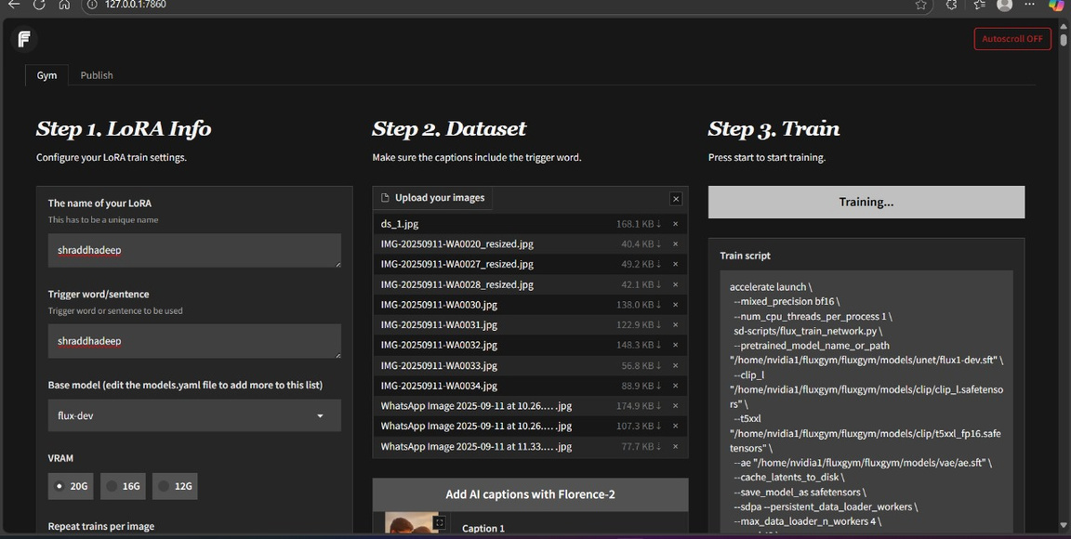
Implementation
LoRA training pipeline
Notes:
<number>

Slide 10
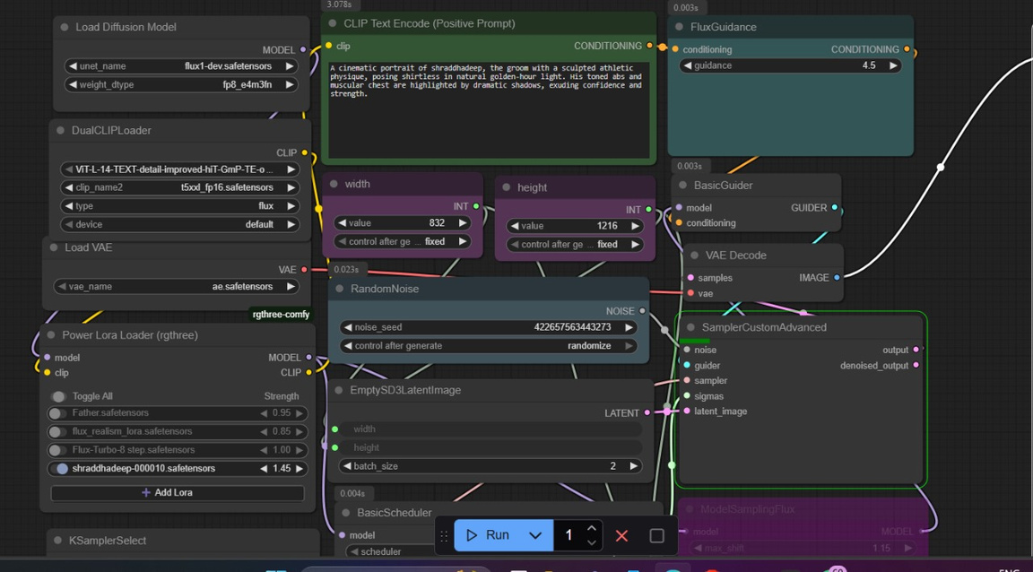
Implementation
Image Generation Pipeline
Notes:
<number>

Slide 11
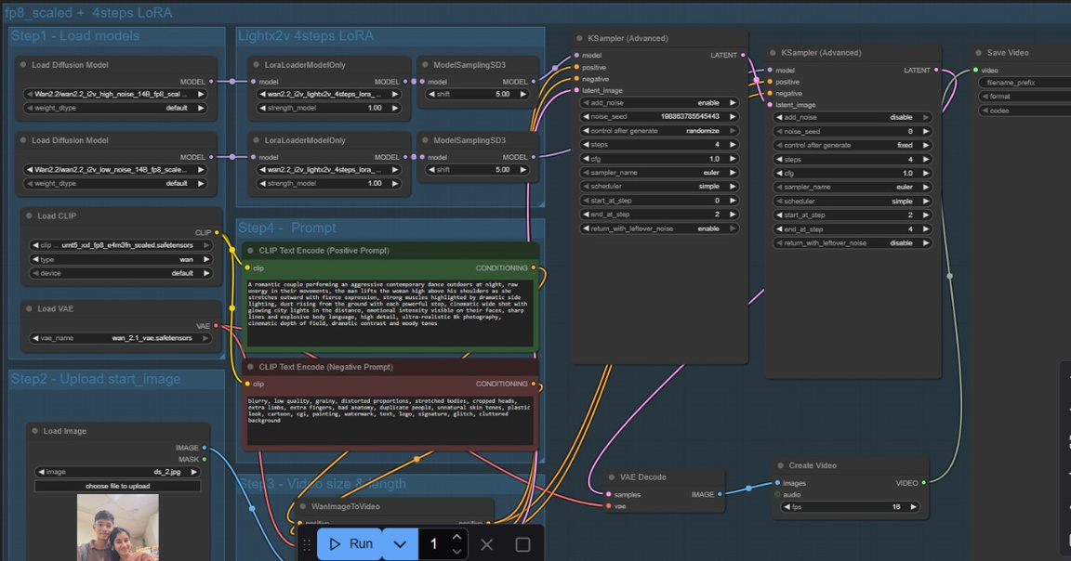
Implementation
Video Generation Pipeline
Notes:
<number>

Slide 12
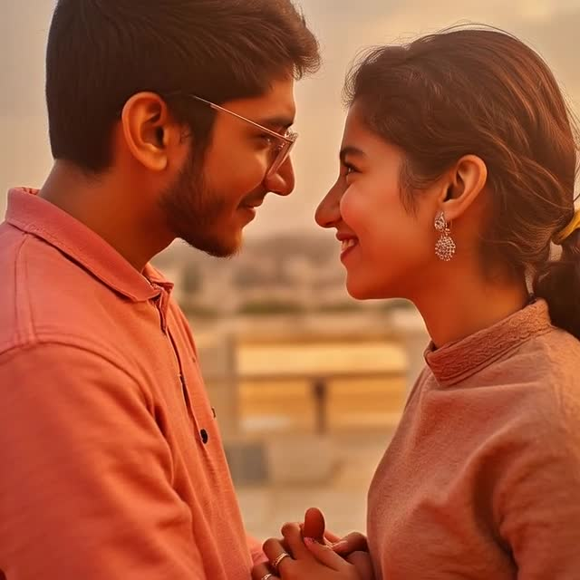
Implementation
Video Output
Notes:
<number>

Slide 13
Conclusion
Our project aims to revolutionize pre-wedding video creation using AI-powered automation.
By combining story-driven inputs with generative media tools, we enable couples to create personalized, cinematic videos with minimal effort and cost.
The system addresses key challenges in the current market and opens up new possibilities for creative, accessible, and emotion-rich storytelling.
This project lays the foundation for the future of AI in personalized video content generation.
Notes:
<number>

Slide 14
Future Ideas (To be Completed in Semester 6 – by May 2026)
Integrate all pipelines into a single, unified system.
Develop a user-friendly UI with multiple wedding and pre-wedding options.
Improve image captioning accuracy and context understanding.
Enhance face consistency and recognition across photos and videos.
Optimize system performance and scalability for deployment.
Notes:
<number>

Slide 15
References
Khachatryan, L., Movsisyan, A., Tadevosyan, V., Henschel, R., Wang, Z., Navasardyan, S., & Shi, H.
Text2Video-Zero: Text-to-Image Diffusion Models are Zero-Shot
Video Generators. arXiv preprint arXiv:2303.13439, 2023.
https://arxiv.org/abs/2303.13439
2. Ho, J., Chan, W., Saharia, C., Whang, J., Gao, R., Gritsenko, A.,
... & Salimans, T.
Imagen Video: High Definition Video Generation with Diffusion
Models. arXiv preprint arXiv:2210.02303, 2022.
https://arxiv.org/abs/2210.02303
3. Reelmind.ai Editorial Team.
AI-Generated Wedding Videos: The Future of Videography.
Reelmind Blog, 2025.
https://reelmind.ai/blog/ai-generated-wedding-videos-the-future-of-videography
Notes:
<number>

Slide 16
Thank You...!!
Notes:
<number>

